Slide 1
Attention Is All You Need
Transformer
陳宜蓁 111705007、范士朋 314511051、陳大福 314511073、翁祐宸 314611104
曾耀陞 A141074、戴廷勳 A141083、謝尚哲 A141163、蔡忻恩 A141199

Slide 2
Outline
Introduction
Model Structure
Attention
Other modules
Self-Attention
Training and Results
Conclusion

Slide 3
Introduction
Background:
Neural machine translation (NMT) systems rely on RNN/CNN encoder–decoder architectures
Attention mechanisms help modeling dependencies, but only as an additional component
Solution - Transformer
eliminates recurrence and convolutions
self-attention
constant path length
more parallelization
Limitation:
Sequential computation in RNNs/CNNs restricts parallelization and slows training, especially for long sequences.
Notes:
Transformer的核心：attention
for large values of dk, the dot products grow large in magnitude, pushing the softmax function into regions where it has extremely small gradients .
To counteract this effect, we scale the dot products by 1/ 根號dk

Slide 4
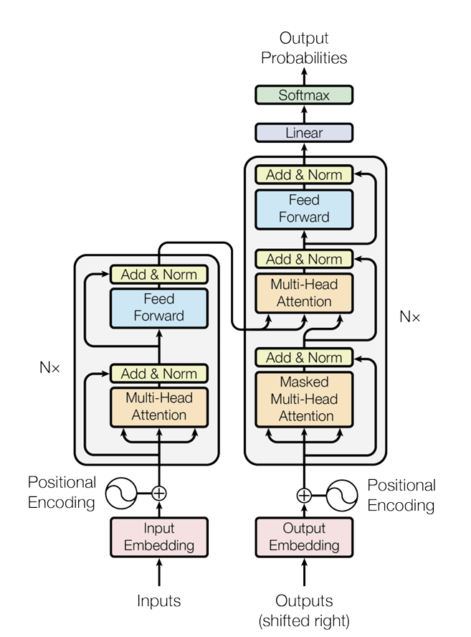
Model Structure
Encoder:
a stack of N = 6 identical layers
two sublayers: multi-head attention, position-wise feed-forward network
residual connection followed by layer normalization
output of each sub-layer :
Decoder:
a stack of N = 6 identical layers
three sublayers: masked multi-head self-attention, multi-head attention, position-wise feed-forward network
ensures output token at position i only depends on tokens before i
Sublayer(x’)
Sublayer(x)
x’
x
Notes:
Transformer的核心：attention
for large values of dk, the dot products grow large in magnitude, pushing the softmax function into regions where it has extremely small gradients .
To counteract this effect, we scale the dot products by 1/ 根號dk

Slide 5
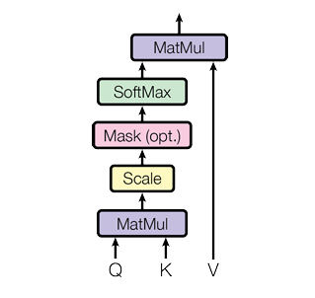


Scaled Dot-Product Attention
much faster and more space-efficient in practice than additive attention
To prevent large dot products:
Notes:
Now, I will introduce the core mechanism of the Transformer, which is called Attention.
The main idea of Attention is to let the model find out which parts of the input are important for making a decision. In Scaled Dot-Product Attention, we have three things: a Query, a set of Keys, and their Values.
First, we compare the Query to each Key by calculating a similarity score. These scores tell us how related each Key is to the Query. Then, we use these scores to create a weighted average of the Values. This makes the model focus more on the important parts.
The formula is:
Here, dk is a scaling factor to prevent the dot products from getting too large. Without this scaling, gradients might become too small during training.
The output is a combination of the Values, where the most important information, based on the Query, is given more weight. This helps the model pay attention automatically to the right information.

Slide 6
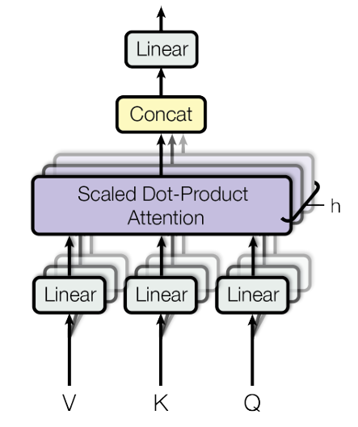
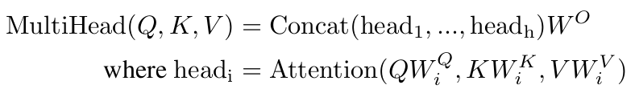
Multi-Head Attention
Linearly project the queries, keys and values h times
Allow the model to jointly attend to information from different representation subspaces at different positions.
Notes:
論文中設定 h = 8，每個 Head 的維度是 64，
總維度仍是 512，因此計算量並沒有變大。
Next, I will explain Multi-Head Attention, which is another key part of the Transformer.
Instead of using Attention only once, the Transformer uses several Attention 'heads' in parallel. Each head learns to focus on different types of information at the same time.
Technically, we first split the input vectors Q, K, and V into h groups using different linear projections. Each group is called a head. We run Scaled Dot-Product Attention separately for each head. Then, we combine the outputs from all heads together.
This way, each head can capture different relationships in the data. For example, one head might learn grammar, another might learn meaning.
In the original paper, h is set to 8, and each head has a dimension of 64. The final combined dimension is still 512, so the computation is efficient.
In short, Multi-Head Attention lets the model learn more complex patterns from the data by looking at it from different perspectives at the same time.

Slide 7
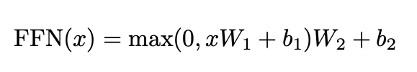
Position-wise Feed-Forward Networks
Applied to each position independently and identically
Two linear layers with ReLU activation
（512 → 2048 → 512）
Enhances non-linearity and transformation capacity
Works together with Attention to form each Transformer layer

Slide 8
Embeddings and Softmax
Positional Encoding
Convert tokens into d_model-dimensional embeddings
Shared weight matrix for input embedding, output embedding, and pre-softmax linear layer
Embedding weights are scaled by √d_model for stable training
Transformer needs position information (no RNN/CNN)
Add sinusoidal positional encodings to embeddings
Enables the model to learn relative and absolute positions

Slide 9
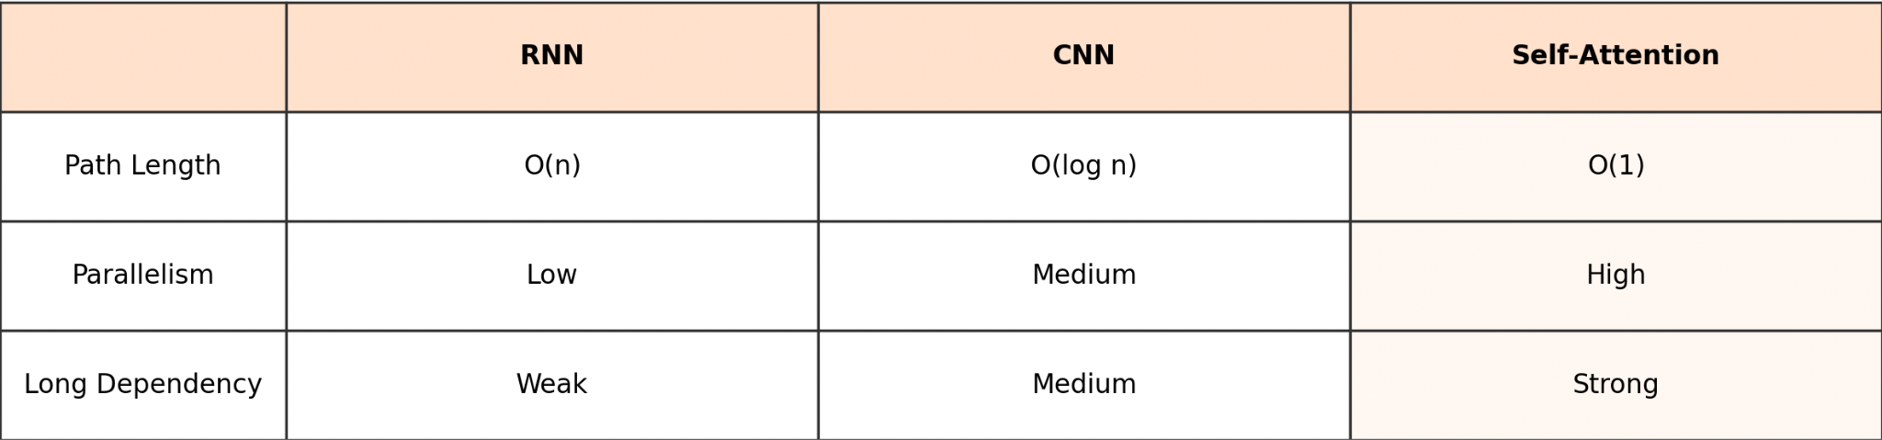
Why Self-Attention?
Enables modeling long-range dependencies in one step
More parallelizable than RNN
Constant path length between any two positions
Handles global context efficiently

Slide 10
Results-Machine Translation
Training Setup
SOTA Results
Dataset: WMT 2014 EN-DE EN-FR
Optimizer: Adam
Learning Rate: Warmup + Inverse Sqrt Decay
EN-DE Translation: 28.4 BLEU
EN-FR Translation: 41.0 BLEU
Key Conclusion: Achieved a new SOTA at a fraction of the training cost.

Slide 11
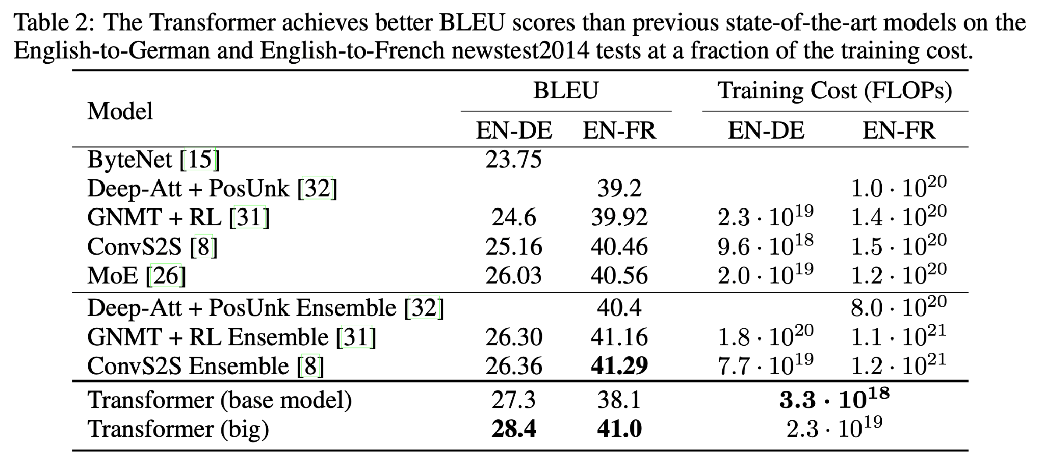

Slide 12
Results-Model Variations
Attention Heads
Key Dimension
Model Size
Positional Encoding
A single head performs worse, but too many heads also degrades quality. 8 heads was optimal.
Reducing the key dimension significantly hurts model quality, suggesting compatibility is non-trivial.
Bigger models perform better. Dropout is essential to prevent overfitting.
Using Sinusoidal or Learned positional encodings resulted in nearly identical performance.

Slide 13
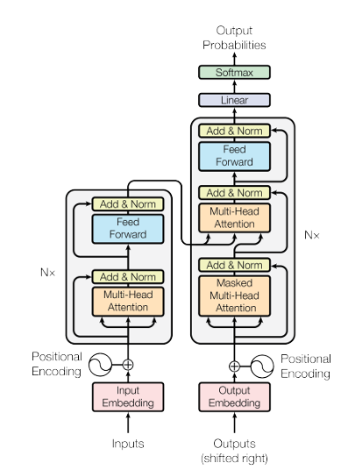
Conclusion & Impact
Contributions
New Architecture: Based solely on attention, dropping RNNs/CNNs for parallelization.
Long-Range: O(1) path length effectively captures long-range dependencies.
SOTA: Faster to train and more accurate, becoming an NLP milestone.
Impact
The foundation for subsequent models: BERT, GPT, T5, ViT.
The core insight: "Attention Is All You Need."

Slide 14
THANKS

